Slide 1

CERTIFICATE III IN AUTOMOTIVE REPAIR & MAINTENANCE
SUBJECT: Automotive Engineering Practice
By Ibrahim siraj
Maldives polytechnic

Slide 2
Automotive Engineering Practice
Chapter 2 Identify Different Parts and their Function of Engine
: Introduction
The engine is the heart of any vehicle or machine.
It converts chemical energy of fuel into mechanical energy.
Based on fuel and ignition type, engines are classified as:
o Petrol Engine (Spark Ignition – SI)
o Diesel Engine (Compression Ignition – CI)
By Ibrahim siraj
Maldives polytechnic

Slide 3
Automotive Engineering Practice
Chapter 2 Identify Different Parts and their Function of Engine
Main Components of an IC Engine
Cylinder Block
Cylinder Head
Piston
Connecting Rod
Crankshaft
Valves (Inlet & Exhaust)
Camshaft
Flywheel
Carburetor / Fuel Injector
Cooling and Lubrication Systems
By Ibrahim siraj
Maldives polytechnic

Slide 4
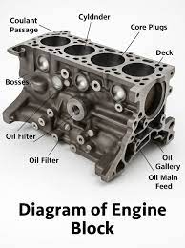
Engine Block
The core structure of the engine; houses cylinders and other components.
Usually made from cast iron or aluminum.
Automotive Engineering Practice
Chapter 2 Identify Different Parts and their Function of Engine
Engine Block
The core structure of the engine; houses cylinders and other components.
Usually made from cast iron or aluminum.
It acts as the engine's foundation, providing a sealed and strong casing for the combustion process, and includes passages for coolant and oil.
By Ibrahim siraj
Maldives polytechnic

Slide 5
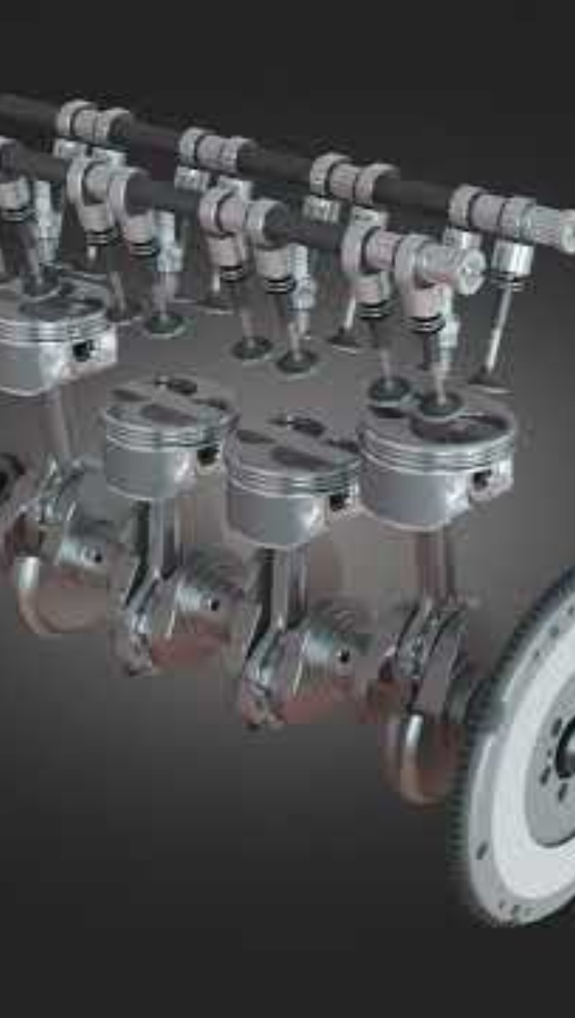
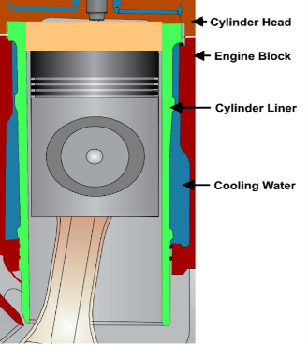
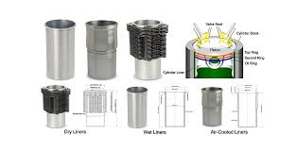
Engine Block
The core structure of the engine; houses cylinders and other components.
Usually made from cast iron or aluminum.
Automotive Engineering Practice
Chapter 2 Identify Different Parts and their Function of Engine
Cylinders
Hollow spaces where pistons move up and down.
Most engines have 4, 6, or 8 cylinders (I4, V6, V8, etc.).
By Ibrahim siraj
Maldives polytechnic

Slide 6
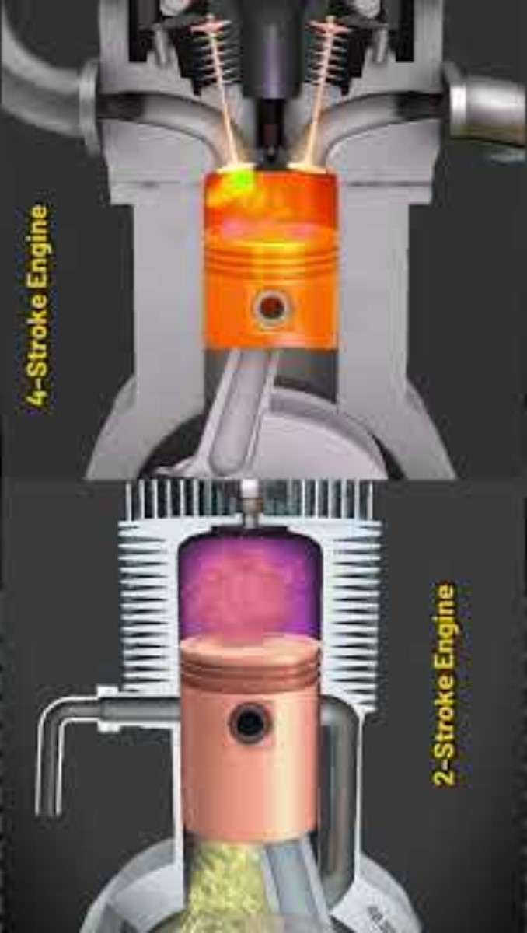
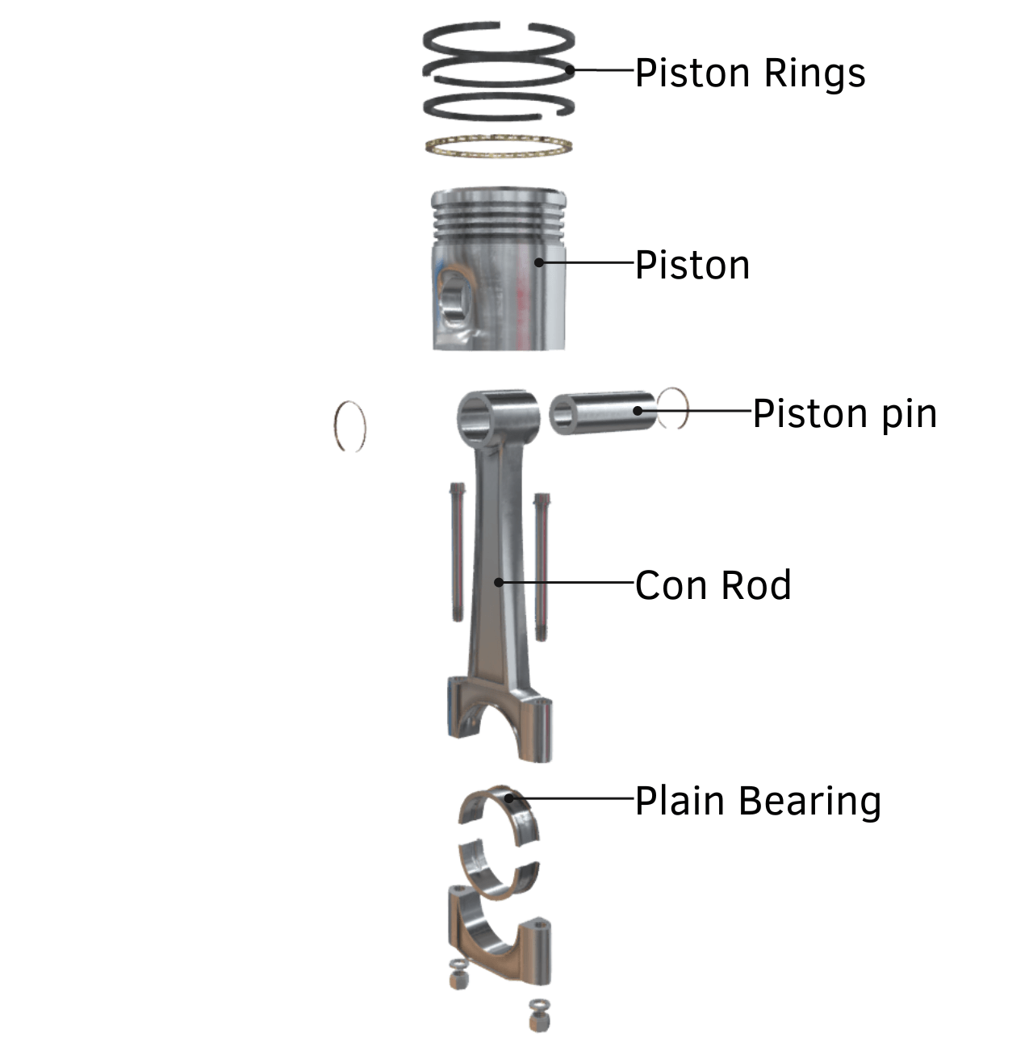
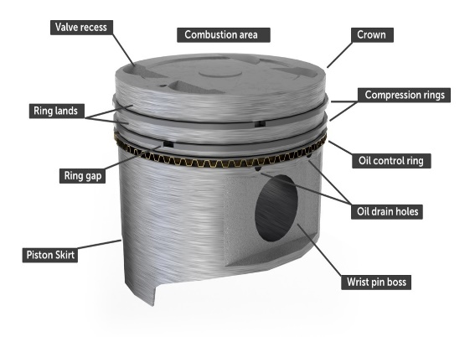
Engine Block
The core structure of the engine; houses cylinders and other components.
Usually made from cast iron or aluminum.
Automotive Engineering Practice
Chapter 2 Identify Different Parts and their Function of Engine
Pistons
Move up and down inside the cylinders.
Convert expanding gas energy into mechanical motion.
By Ibrahim siraj
Maldives polytechnic

Slide 7
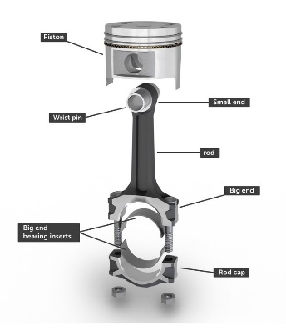
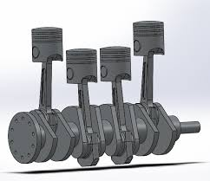
Automotive Engineering Practice
Chapter 2 Identify Different Parts and their Function of Engine
Connecting Rods
Connect pistons to the crankshaft.
Transfer motion from the piston to the crankshaft.
By Ibrahim siraj
Maldives polytechnic

Slide 8
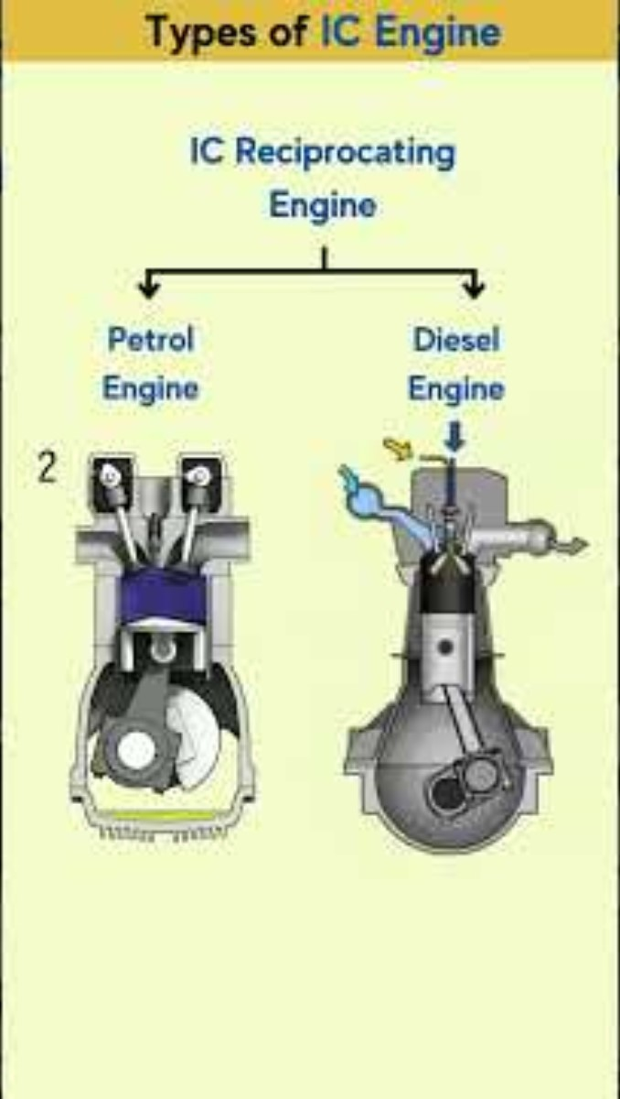
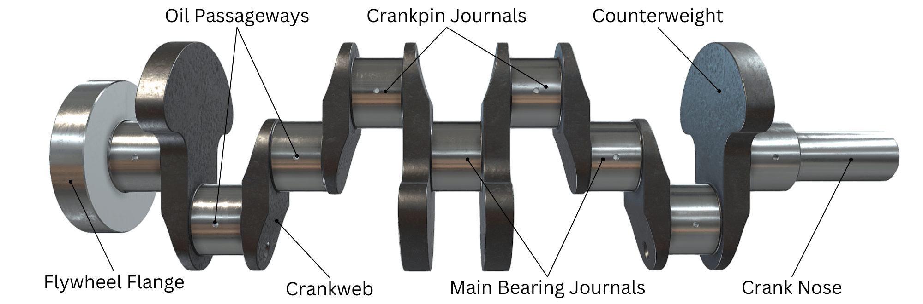
Automotive Engineering Practice
Chapter 2 Identify Different Parts and their Function of Engine
Crankshaft
Converts linear motion of pistons into rotational motion.
Drives the vehicle’s wheels (indirectly).
By Ibrahim siraj
Maldives polytechnic

Slide 9
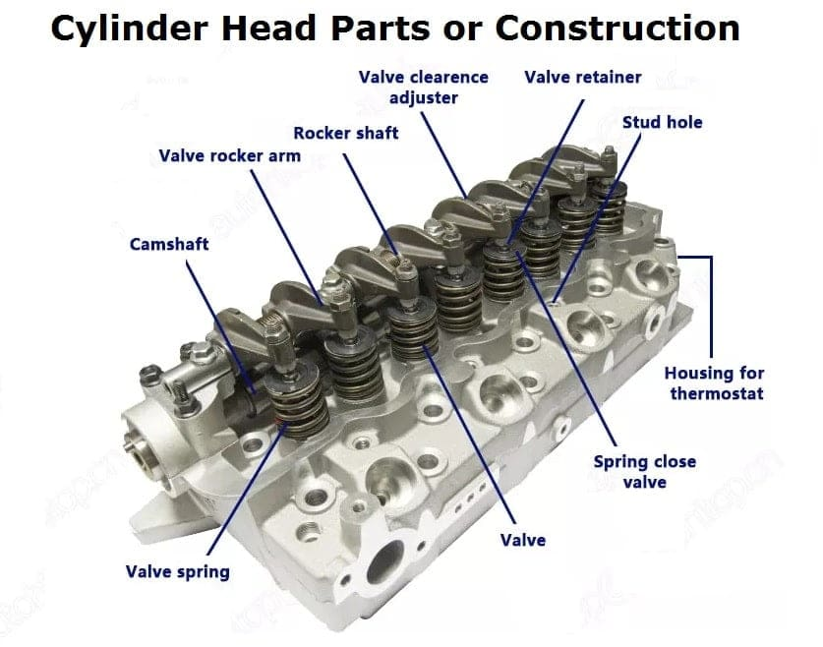
Automotive Engineering Practice
Chapter 2 Identify Different Parts and their Function of Engine
Cylinder Head
Sits on top of the engine block, sealing the cylinders.
Contains valves, spark plugs, and camshafts (in OHC engines).
By Ibrahim siraj
Maldives polytechnic

Slide 10
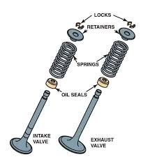
Automotive Engineering Practice
Chapter 2 Identify Different Parts and their Function of Engine
Valves (Intake & Exhaust)
Open and close to let air-fuel mixture in and exhaust gases out.
Controlled by the camshaft(s).
By Ibrahim siraj
Maldives polytechnic

Slide 11
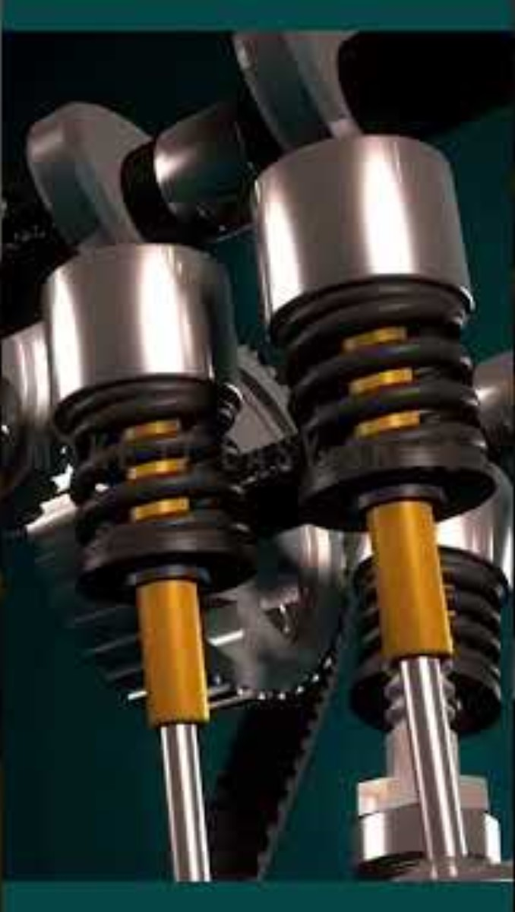
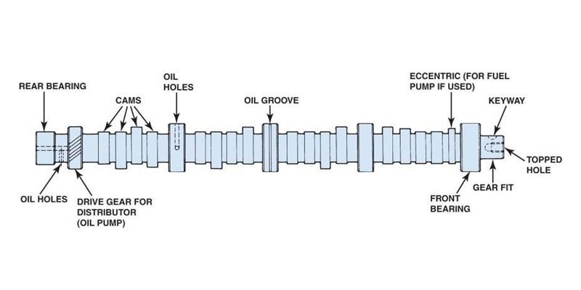
Automotive Engineering Practice
Chapter 2 Identify Different Parts and their Function of Engine
Camshaft
Operates the valves via lifters, pushrods, and rocker arms (in OHV engines).
Often driven by the timing belt or chain.
By Ibrahim siraj
Maldives polytechnic

Slide 12
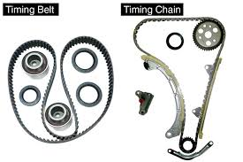
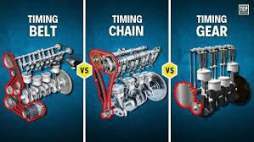
Automotive Engineering Practice
Chapter 2 Identify Different Parts and their Function of Engine
Timing Belt / Timing Chain
Synchronizes the rotation of the crankshaft and camshaft.
Ensures valves open and close at the right time.
By Ibrahim siraj
Maldives polytechnic

Slide 13
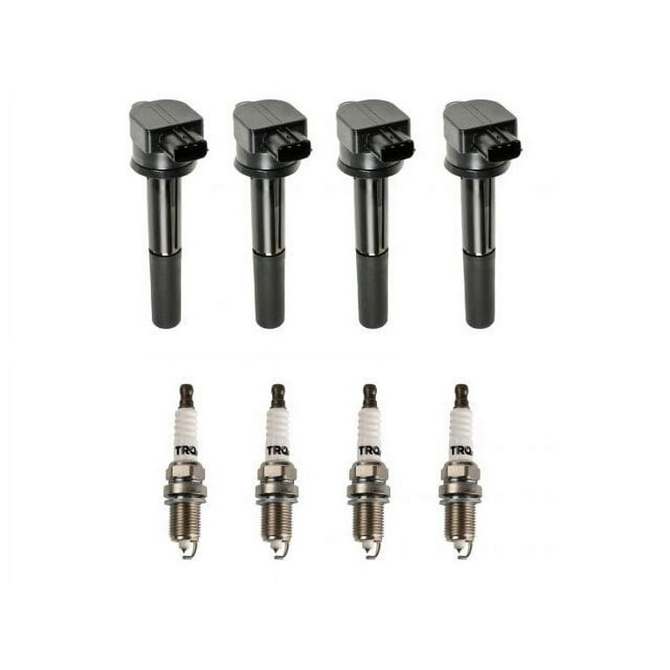
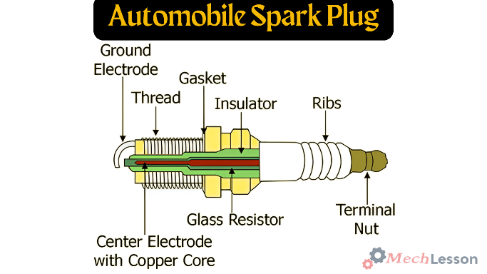
Automotive Engineering Practice
Chapter 2 Identify Different Parts and their Function of Engine
Spark Plugs (in gasoline engines)
Ignite the air-fuel mixture in each cylinder.
By Ibrahim siraj
Maldives polytechnic

Slide 14
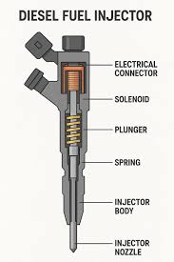
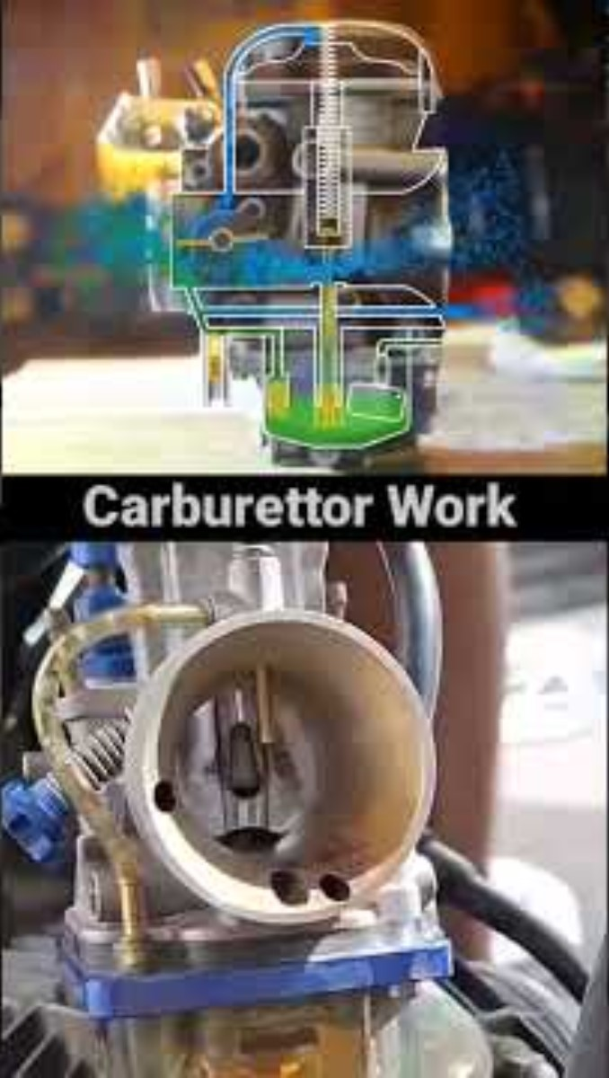
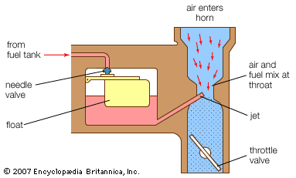
Automotive Engineering Practice
Chapter 2 Identify Different Parts and their Function of Engine
Fuel Injectors / Carburetor
Deliver fuel to the engine.
Injectors are used in modern engines; carburetors in older ones.
By Ibrahim siraj
Maldives polytechnic

Slide 15
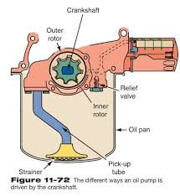
Automotive Engineering Practice
Chapter 2 Identify Different Parts and their Function of Engine
Oil Pump
Circulates engine oil to lubricate moving parts.
By Ibrahim siraj
Maldives polytechnic

Slide 16
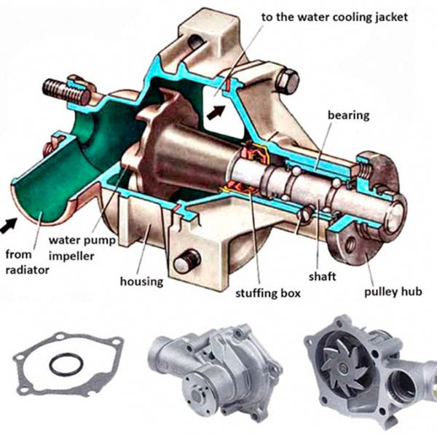
Automotive Engineering Practice
Chapter 2 Identify Different Parts and their Function of Engine
Water Pump
Circulates coolant through the engine and radiator to manage temperature.
By Ibrahim siraj
Maldives polytechnic

Slide 17
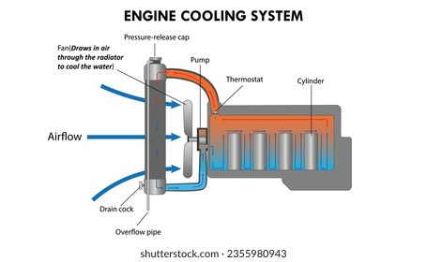
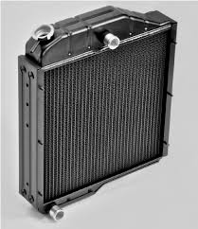
Automotive Engineering Practice
Chapter 2 Identify Different Parts and their Function of Engine
Radiator
Cools the engine coolant.
Helps prevent the engine from overheating.
By Ibrahim siraj
Maldives polytechnic

Slide 18
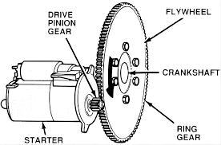
Automotive Engineering Practice
Chapter 2 Identify Different Parts and their Function of Engine
Flywheel / Flexplate
Stores rotational energy.
Helps maintain smooth engine rotation; connects to the transmission
By Ibrahim siraj
Maldives polytechnic

Slide 19
Automotive Engineering Practice
Chapter 2 Identify Different Parts and their Function of Engine
Additional Components
Air Intake System – Brings air into the engine.
Exhaust Manifold – Channels exhaust gases out of the engine.
Turbocharger / Supercharger (if present) – Forces more air into the engine for more power.
Engine Control Unit (ECU) – The computer that manages fuel injection, timing, and other parameters.
Gaskets & Seals – Ensure airtight and leak-proof operation between engine components.
By Ibrahim siraj
Maldives polytechnic

Slide 20
THANK YOU

